Slide 1


Datasheet for Subjective and Objective Quality Assessment Datasets
VQEG Spring Meeting 2023
June 26-30, 2023
Nabajeet Barman§*, Yuriy Reznik‡ and Maria Martini§
§Kingston University, London
‡ Brightcove Inc
*This work was done in part when first author was at Brightcove

Slide 2

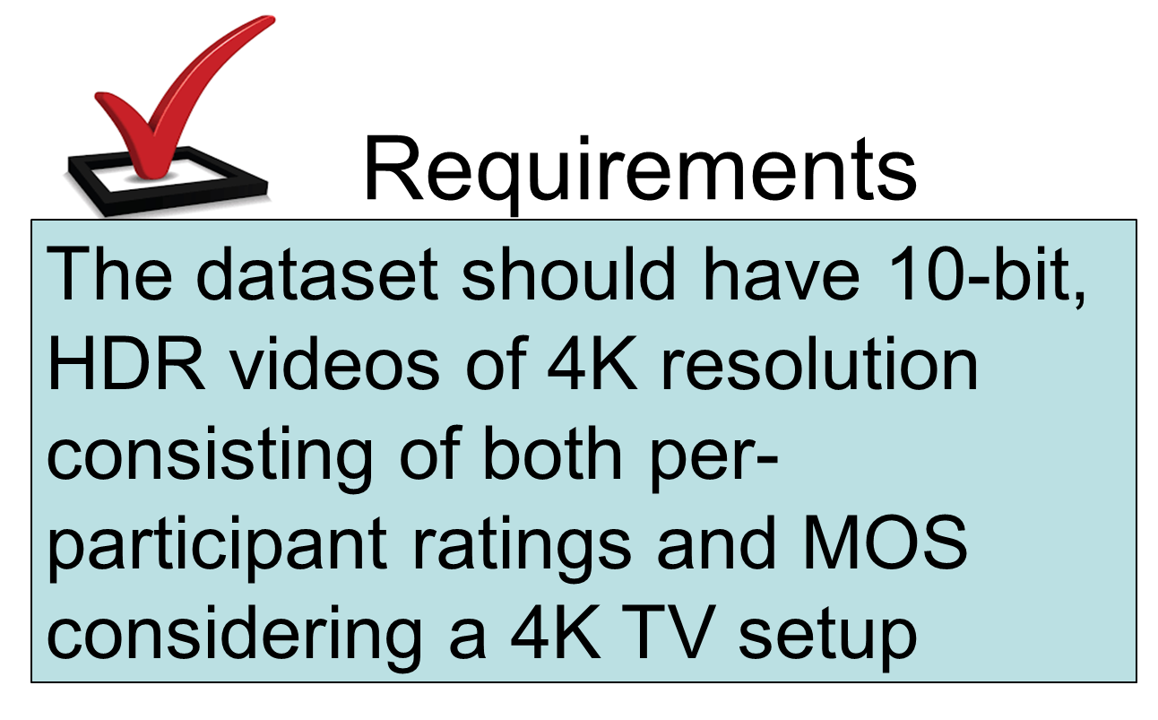
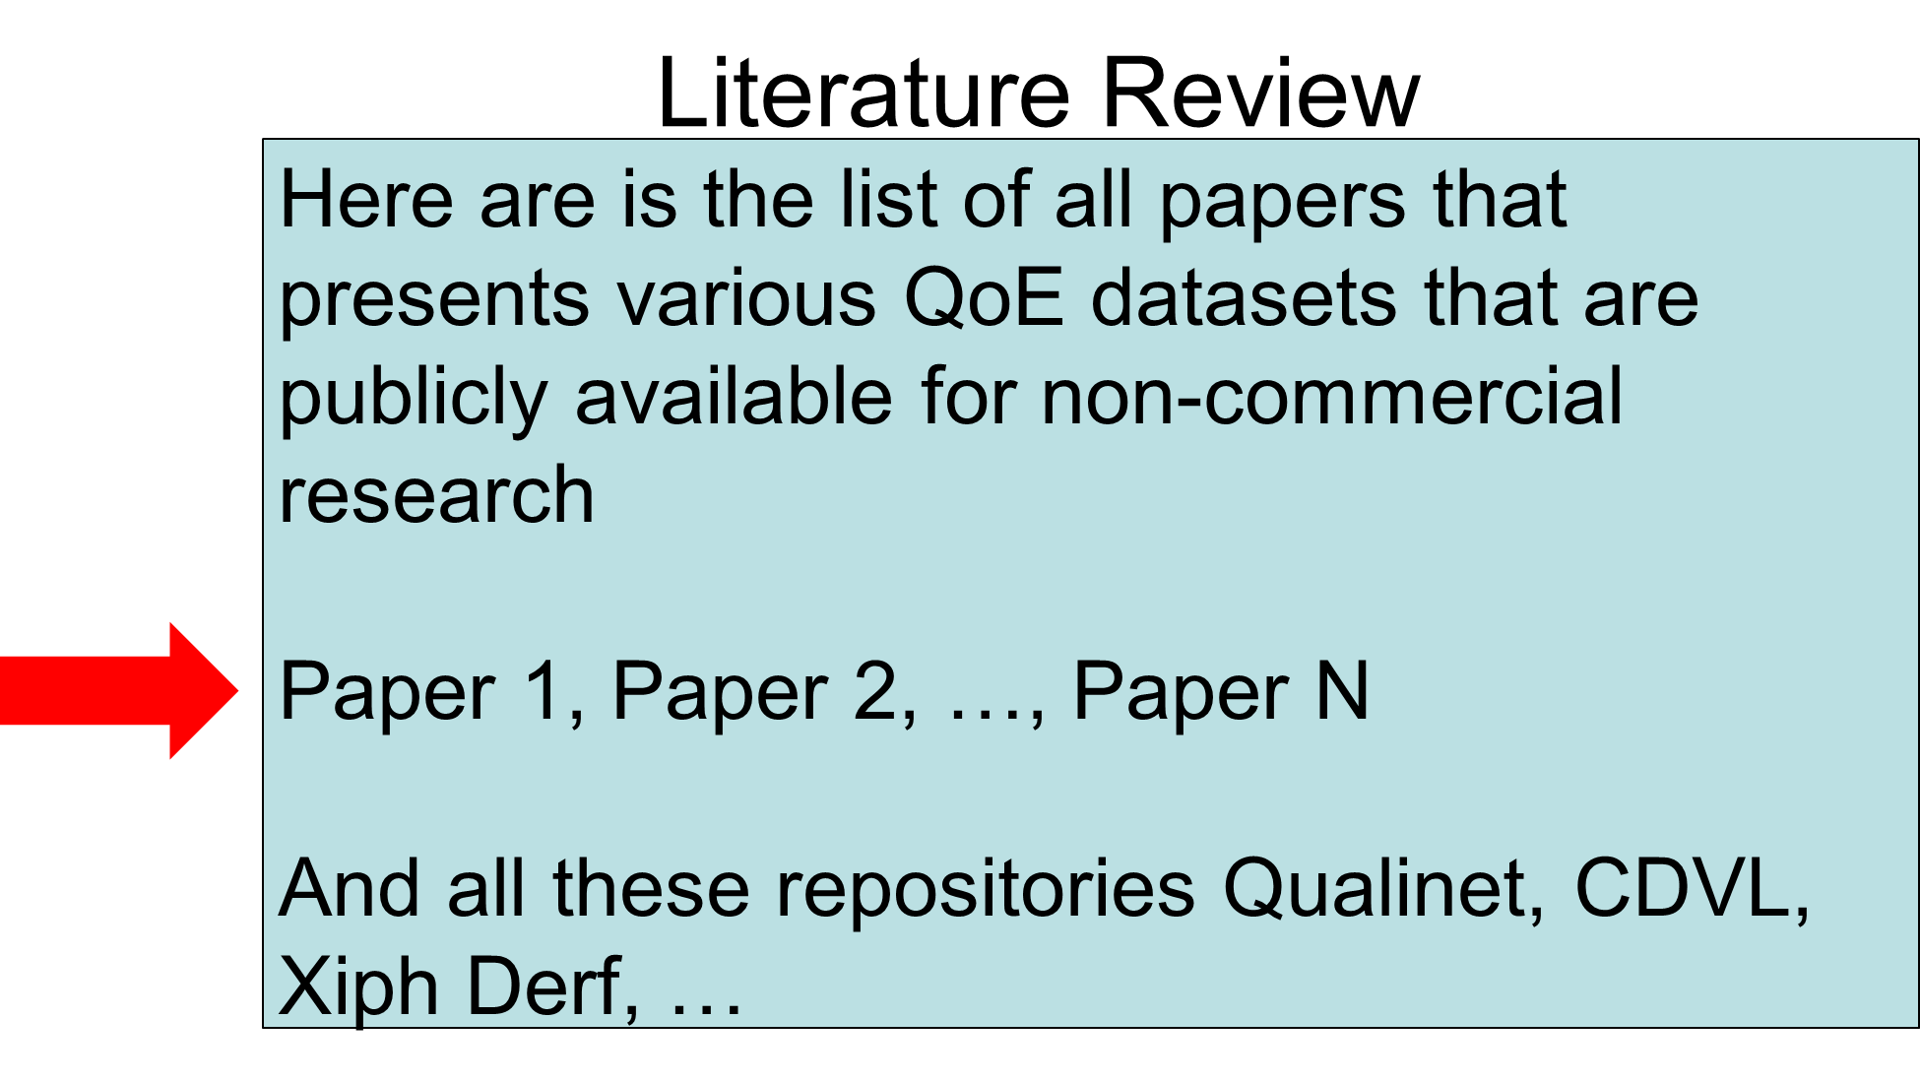
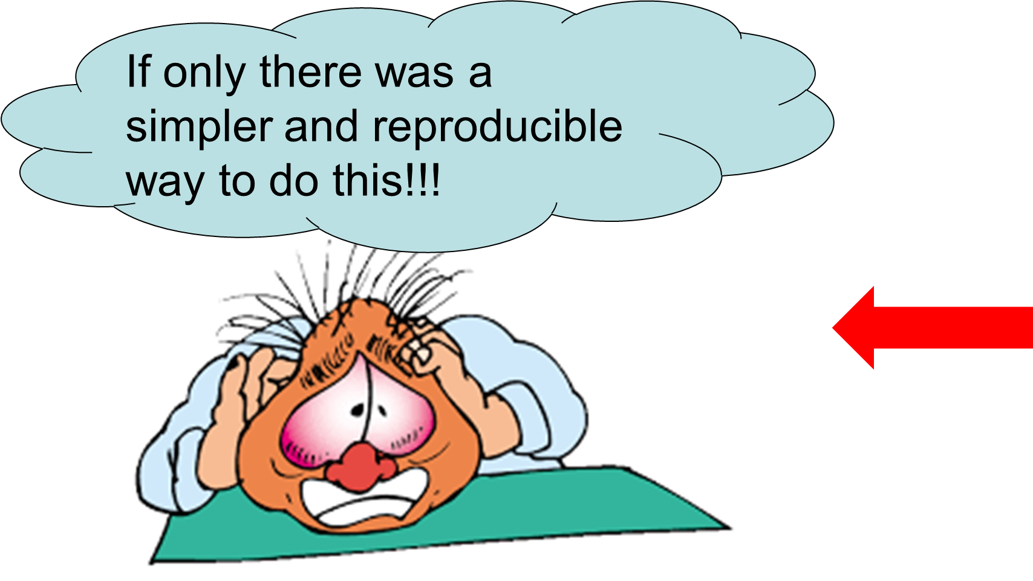
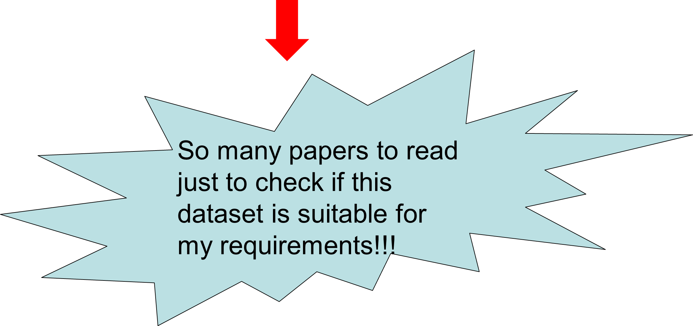

Problem Statement: A typical scenario faced by most QoE researchers!!!

Slide 3

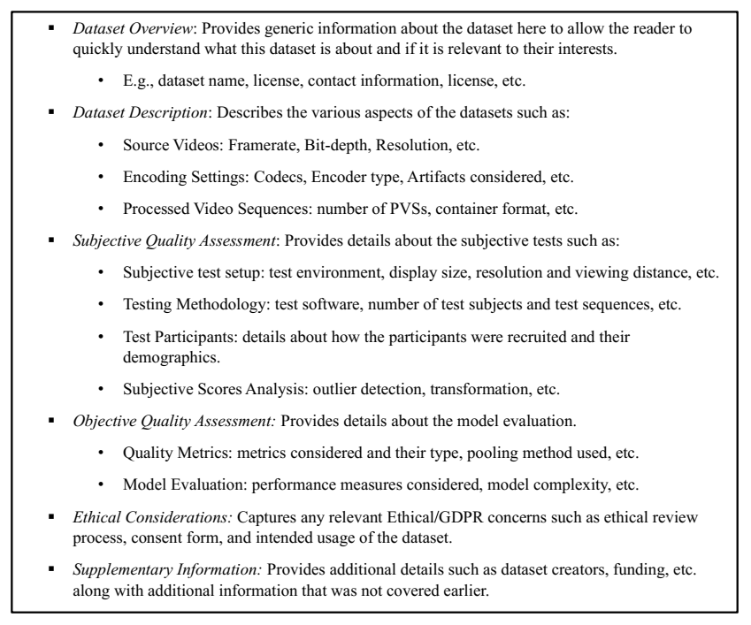

Slide 4

https://github.com/NabajeetBarman/datasheet-for-qoe-datasets

Slide 5
Thanks
Co-Authors, Dr Yuriy Reznik and Prof Maria Martini
Saman, Steven and Rakesh for feedback on the first draft template
Margaret, Kjell, Ioannis and Enrico for their support!

Slide 6
Next Steps
Feedback on the current template
  Improve
  Finalize
  Standardize (ITU-T Recommendation)?
More example datasheets!!!
Design new templates for other modalities (360, Light Field, etc.)
  Interest?

Slide 7
Nabajeet.Barman@kingston.ac.uk

